Slide 1
SOLID Principles
Design Principles and Approaches
S
Single Responsibility
O
Open/Closed
L
Liskov substitution
I
Interface Segregation
SoftUni Team
D
Dependency Inversion
Technical Trainers
Software University
http://softuni.bg

Slide 2
Table of Contents
Single Responsibility
Open/Closed
Liskov Substitution
Interface Segregation
Dependency Inversion

Slide 3
Questions
sli.do #fund-csharp

Slide 4
Why Clean Code Matters?
How clean code (or its absence) affects our software?
"...So if you want to go fast,
if you want to get done quickly,
if you want your code to be easy to write,
make it easy to read."
– Robert C. Martin

Slide 5

Single Responsibility

Slide 6
What is Single Responsibility?
Every class should be responsible for only a single part of the functionality and that responsibility should be entirely encapsulated by the class.
"There should never be more than one reason for a class to change."
- Robert C. "Uncle Bob" Martin

Slide 7
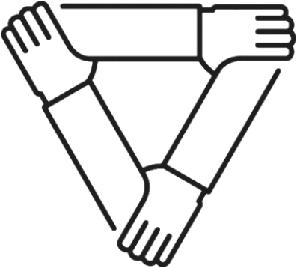
Strong Cohesion / Loose Coupling
Cohesion refers to the grouping of functionally related processes into a particular module.
Aim for strong cohesion
Each task maps a single code unit
A method should do one operation
A class should represent one entity
Notes:
Cohesion
Low: The convenience store. You go there for everything from gas to milk to ATM banking. Products and services have little in common, and the convenience of having them all in one place may not be enough to offset the resulting increase in cost and decrease in quality.
High: The cheese store. They sell cheese. Nothing else. Can't beat 'em when it comes to cheese though.
More inner instance variables – harder cohesion
Coupling
Loose: You and the guy at the convenience store. You communicate through a well-defined protocol to achieve your respective goals - you pay money, he lets you walk out with the bag of Cheetos. Either one of you can be replaced without disrupting the system.
Tight: You and your wife.

Slide 8
Strong Cohesion / Loose Coupling (2)
Coupling – the degree of dependence between modules
How closely connected two modules are
The strength of the relationship between modules
Aim for loose coupling
Supports readability and maintainability
Often a sign of good system design
Notes:
Cohesion
Low: The convenience store. You go there for everything from gas to milk to ATM banking. Products and services have little in common, and the convenience of having them all in one place may not be enough to offset the resulting increase in cost and decrease in quality.
High: The cheese store. They sell cheese. Nothing else. Can't beat 'em when it comes to cheese though.
More inner instance variables – harder cohesion
Coupling
Loose: You and the guy at the convenience store. You communicate through a well-defined protocol to achieve your respective goals - you pay money, he lets you walk out with the bag of Cheetos. Either one of you can be replaced without disrupting the system.
Tight: You and your wife.

Slide 9
Cohesion and Coupling - Approaches
Small number of instance variables inside a class
Each method of a class should manipulate one or more of those variables
Two modules should exchange as little information as possible
Creating an easily reusable subsystem

Slide 10


Open/Closed

Slide 11
What is the Open/Closed Principle?
Software entities like classes, modules and functions should be open for extension, but closed for modifications
Extensibility
Adding a new behavior doesn’t require changes over existing source code
Reusability
subsystems are suitable for reusing in other projects – modularity

Slide 12
Design Smell - Violations
Need to retest after changes
Old parts changed -> possible bugs
Cascading changes through modules
Logic depends on conditional statements (“IS-A” checking)

Slide 13
OCP - Approaches
Parameters
Control behavior specifics via a parameter or a delegate
Rely on abstraction, not implementation
Inheritance / Template Method Pattern
Strategy Pattern
Plug in model (insert a new implementation of the interface)
Notes:
When we use abstraction there is no limit in implementation

Slide 14
OCP - When to Apply
By experience – know the problem domain and if a change is very likely to recur
New domain problem – implement the most simple way
Changes once – modify, second time – refactor
TANSTAAFL – There Ain’t No Such Thing As A Free Lunch
OCP adds complexity to design
No design can be closed against all changes - know which ones to guard
Notes:
It's best not to try to predict the future, but once a change is needed, modify the design so future changes of that same kind can be accommodated.

Slide 15
Template Method Pattern
AbstractClass
+ templateMethod()
+ stepOne()
+ stepTwo()
. . .
Varying behavior
ConcreteClassOne
+ stepOne()
+ stepTwo()
ConcreteClassTwo
+ stepOne()
+ stepTwo()
Implementation

Slide 16
Template Method Pattern (2)
public abstract class CrossCompiler
{
public void CrossCompile()
{
this.CollectSource();
this.CompileToTarget();
}
protected abstract void CollectSource();
protected abstract void CompileToTarget();
}
Template method

Slide 17
Template Method Pattern (3)
public class IPhoneCompiler : CrossCompiler
{
protected override void CollectSource() protected override void CompileToTarget()
{ //iphone specific compilation }
}
public class AndroidCompiler : CrossCompiler
{
protected override void CollectSource()
protected override void CompileToTarget()
{ //android specific compilation }
}

Slide 18
Problem: Stream Progress Info
Refactor the skeleton given for this problem:
StreamProgressInfo class must work with Music class too
Make sure that if you add a new class, which provides BytesSent and Length, getters will work without touching StreamProgressInfo

Slide 19
Solution: Stream Progress Info
public class StreamProgressInfo
{
private IStreamable streamable;
public StreamProgressInfo(IStreamable streamResult)
{
this.streamable = streamResult;
}
public int CalculateStreamProgress()
{
return (this.streamable.BytesSent * 100) /
this.streamable.Length;
}
}
Notes:
There are two ways to achieve abstraction
- Using Abstract Classes
- Using Interfaces

Slide 20
Solution: Stream Progress Info (2)
public interface Istreamable
{
int Length { get; }
int BytesSent { get; }
}
public class File : IStreamable
{
//TODO: Add business logic
}
public class Music : IStreamable
{
//TODO: Add business logic
}
Notes:
There are two ways to achieve abstraction
- Using Abstract Classes
- Using Interfaces

Slide 21
Problem: Graphic Editor
Refactor the skeleton given for this task so that:
GraphicEditor class draws all kinds of shapes without asking what kind of shape we pass
Be sure if you add a new type of shape, the system will still work correctly without touching GraphicEditor

Slide 22
Solution: Graphic Editor
public interface IShape
{
void Draw();
}
public class Rectangle : IShape
{
public void Draw()
{ Console.WriteLine("I'm Rectangle"); }
}
public class GraphicEditor
{
void DrawShape(Shape shape)
{ shape.Draw(); }
}
Make the same for Circle
Notes:
There are two ways to achieve abstraction
- Using Abstract Classes
- Using Interfaces

Slide 23

Liskov Substitution

Slide 24
LSP - Substitutability
Derived types must be completely substitutable for their base types
Derived classes
only extend functionalities of the base class
must not remove base class behavior
Student IS-SUBSTITUTED-FOR Person

Slide 25

Design Smell - Violations
Type Checking
Overridden methods say "I am not implemented"
Base class depends on its subtypes

Slide 26
OCP – Approaches
Tell Don’t Ask
If you need to check what is the object - move the behavior inside the object
New Base Class – if two classes share a common behavior, but are not substitutable, create a third, from which both derive
There shouldn’t be any virtual methods in constructors
Notes:
Usually from base ctor to child
Virtual methods from child to base
Base class – depends on the child

Slide 27

Interface Segregation

Slide 28
What is Interface Segregation?
Segregate interfaces
Prefer small, cohesive (lean and focused) interfaces
Divide "fat" interfaces into "role" interfaces
"Clients should not be forced to depend on methods they do not use."
- Agile Principles, Patterns and Practices in C#
Notes:
Получава се в два случая – малко от вас ще тръгнат да пишат огромни интерфейси, но дори и при два метода може да се получи грешка

Slide 29
Fat Interfaces
Classes whose interfaces are not cohesive have "fat" interfaces
public interface IWorker
{
void Work();
void Sleep();
}
public class Robot : IWorker
{
void Work() { … }
void Sleep()
{ throw new NotImplementedException() }
}

Slide 30
Design Smells - Violations
Not implemented methods
A Client references a class, but only uses a small portion of it
"Abstraction is elimination
of the irrelevant and
amplification of the essential."
– Robert C. Martin

Slide 31
ISP - Approaches
What does the client see and use?
The "fat" interfaces implement a number of small interfaces with just what you need
All public members of a class divided in separate classes – again, could be thought of as an interface
Let the client define interfaces – "role" interfaces

Slide 32
Cohesive Interfaces
Small and Cohesive "Role" Interfaces
public interface IWorker
{
void Work();
}
public interface ISleeper
{
void Sleep();
}
public class Robot : IWorker
{
void Work() { // Do some work… }
}

Slide 33
Adapter Pattern
Problem that the Adapter pattern solves
Reusing classes that do not have an interface that a client requires
Making classes with incompatible interfaces work together
Providing an alternative interface for a class

Slide 34
Adapter Pattern
Convert the incompatible interface of a class Adaptee into another interface – Target, that clients require
class Adaptee
{
public void SpecificRequest()
{
Console.Write
("Called SpecificRequest()");
}
}
interface Target
{
void Request();
}

Slide 35
Adapter Pattern (2)
Define a separate class – Adapter, that does the job
class Adapter : Target
{
private Adaptee adaptee = new Adaptee();
public void Request()
{
// Possibly do some other work
adaptee.SpecificRequest();
}
}

Slide 36
Problem: Detail Printer
Refactor the skeleton given for this task so that
DetailsPrinter class prints correctly any kind of employee, which is in the collection
Remove any "is" statements from your code
Be sure if you add a new type of employee, the system will work correctly without touching DetailsPrinter

Slide 37
Solution: Detail Printer
public class Employee
{
private string name;
public Employee(string name)
{
this.name = name;
}
public override string ToString()
{
return $"Name: {this.name}";
}
}
Notes:
There are two ways to achieve abstraction
- Using Abstract Classes
- Using Interfaces

Slide 38
Solution: Detail Printer (2)
public class Manager : Employee
{
public Manager(string name,
ICollection<string> documents) : base(name)
{
this.Documents = new List<string>(documents);
}
public IReadOnlyCollection<string> Documents { get; set; }
public override string ToString()
{
return base.ToString() + $"Documents:
{string.Join(Environment.NewLine, this.Documents)}";
}
}
Notes:
There are two ways to achieve abstraction
- Using Abstract Classes
- Using Interfaces

Slide 39
Solution: Detail Printer (3)
public class DetailsPrinter
{
private IList<Employee> employees;
public DetailsPrinter(IList<Employee> employees)
{
this.employees = employees;
}
public void PrintEmployees()
{
foreach(Employee employee in employees)
Console.WriteLine(employee);
}
}
Notes:
There are two ways to achieve abstraction
- Using Abstract Classes
- Using Interfaces

Slide 40
Problem: Recharge
New feature
You are given some classes
Refactor the code, so that it conforms to ISP
Consider the case that you don't own the library
Recharge Station
<IRechargeable>
(A) Worker
Current library
Employee
Robot

Slide 41
Solution: Rechargeable
Multiple Inheritance (If you own the library)
Recharge Station
<IRechargeable>
<ISleeper>
(A) Worker
Robot
Employee

Slide 42
Solution: Rechargeable (2)
Adapter Pattern (If you don't own the library)
Recharge Station
<IRechargeable>
(A) Worker
RobotAdapter
Robot
Employee

Slide 43

Dependency Inversion

Slide 44
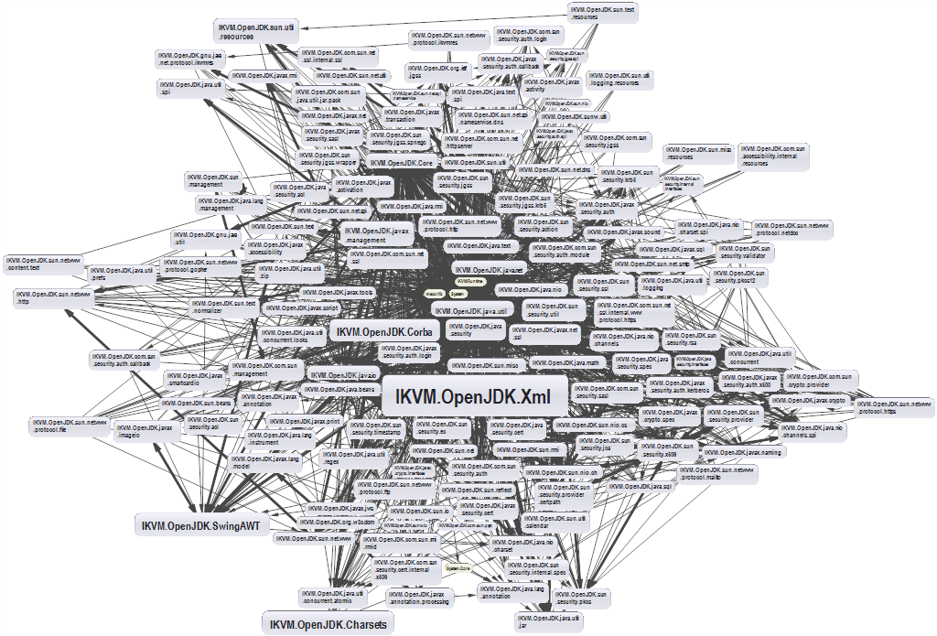
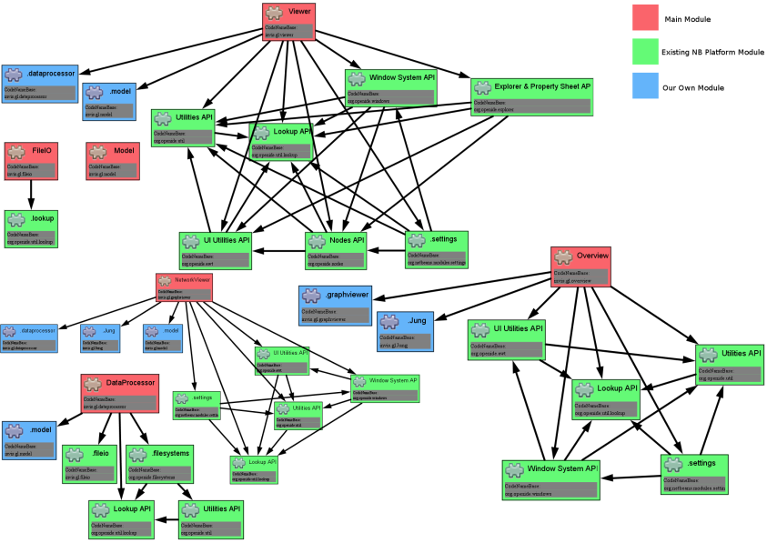
Dependencies and Coupling
Depend directly on other modules
Depend on abstractions

Slide 45
Dependency Examples
A dependency is any external component / system:
Framework
3rd party library
Database
File system
Email
Web service
System resource (e.g. clock)
Configuration
The new keyword
Static method
Global function
Random generator
Console
Notes:
A dependency is any external component / system:
Framework
Third party library
Database
File system
Email
Web service
System resource (e.g. clock)
Configuration
The new keyword
Static method
Global function
Random generator
Console

Slide 46
Dependencies in Traditional Programming
UI
Business Layer
Infrastructure
Database
Utilities
External libraries
Notes:
Traditional programming
High level modules use lower lever modules
E.g. UI depends on the Business Layer
Business layer depends on Infrastructure, database, utilities, External libraries
Static methods (Façade for example)
Classes are instantiated everywhere

Slide 47
Depend on Abstractions
class
Copy
class
Copy
interface
Reader
interface
Writer
class
Keyboard
class
Printer
class
KeyboardReader
class
PrinterWriter
Notes:
Depend on Abstractions
Depend on abstractions means to work through interfaces instead directly use dependent classes

Slide 48



Types of Dependency Injection
Constructor
injection
Property
injection
Parameter
injection

Slide 49
Constructor Injection – Pros and Cons
Pros
Class’ requirements are self-documenting
We don’t have to worry about state validation
Cons
Too many parameters
Sometimes, the functionality doesn’t need all of the dependencies

Slide 50
Constructor Injection - Example
class Copy
{
private IReader reader;
private IWriter writer;
public Copy(IReader reader, IWriter writer)
{
this.reader = reader;
this.writer = writer;
}
// Read/Write data through the reader/writer
}
var copy = new Copy(new ConsoleReader(),
new FileWriter("out.txt"));

Slide 51
Property Injection – Pros and Cons
Pros
Functionality can be changed at any time
That makes the code very flexible
Cons
State can be invalid
Less intuitive to use

Slide 52
Property Injection - Example
class Copy
{
public IReader Reader { get; set; }
public IWriter Writer { get; set; }
public void CopyAllChars(reader, writer)
{
// Read/Write data through the reader/writer
}
}
Copy copy = new Copy();
copy.Reader = new ConsoleReader();
copy.Writer = new FileWriter("output.txt");
copy.CopyAllChars();

Slide 53
Parameter Injection – Pros and Cons
Pros
Changes are only localized to the method
Cons
Too many parameters
Breaks the method signature

Slide 54
Parameter Injection - Example
class Copy
{
public CopyAllChars(IReader reader, IWriter writer)
{
// Read/Write data through the Reader/Writer
}
}
Copy copy = new Copy();
var reader = new ConsoleReader();
var writer = new FileWriter("output.txt");
copy.CopyAllChars(reader, writer);

Slide 55
DIP Violations
Classic DIP Violations:
Using the new keyword
Using static methods / properties
How to fix code, that violates the DIP:
Extract interfaces + use constructor injection
Set up an Inversion of Control (IoC) container
Notes:
Classic violations of DIP
Using of the new keyword
Using static methods / properties
How to fix broken DIP?
Extract interfaces + use constructor injection
Inversion of Control (IoC) container

Slide 56

Summary
…
…
…
SOLID principle make software more:
Understandable
Flexible
Maintainable

Slide 57
https://softuni.bg/courses/csharp-oop-advanced

Slide 58











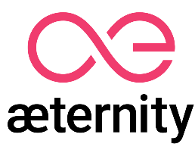
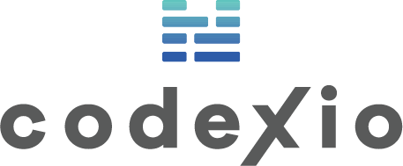
SoftUni Diamond Partners

Slide 59

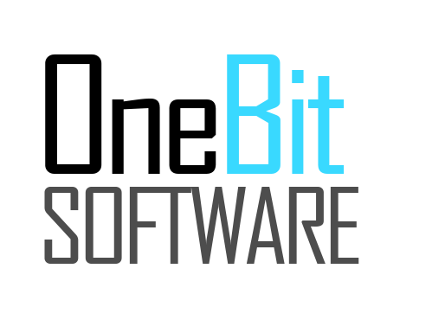



SoftUni Organizational Partners

Slide 60




Trainings @ Software University (SoftUni)
Software University – High-Quality Education and Employment Opportunities
softuni.bg
Software University Foundation
http://softuni.foundation/
Software University @ Facebook
facebook.com/SoftwareUniversity
Software University Forums
forum.softuni.bg

Slide 61

License
This course (slides, examples, demos, videos, homework, etc.) is licensed under the "Creative Commons Attribution-NonCommercial-ShareAlike 4.0 International" license

